Slide 1
Classification in machine learning
By Farheen Anwar

Slide 2
agenda
Introduction
About Dataset
Preprocessing
Types of Classification
Application on Data
Comparisons
Final Results

Slide 3

Classification is a supervised learning where data has categorical target variable

Slide 4
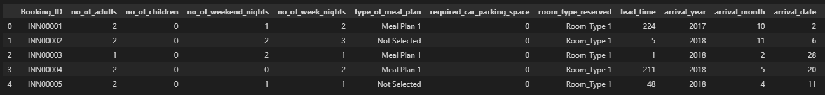
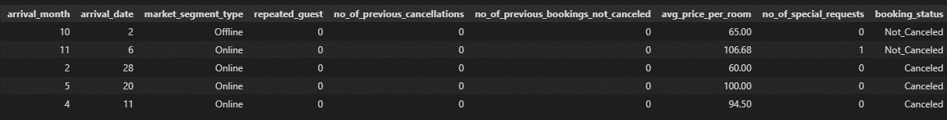
About DATASET
Binomial dataset of online hotel reservation which predict that whether the customer is going to honor the reservation or cancel it
18 Features (3 categorical, 15 numeric)
Target variable (booking_status) has two possible outcomes (cancelled or not cancelled)
36276 observation

Slide 5
DROPPING IRRELEVANT COLUMN

Slide 6
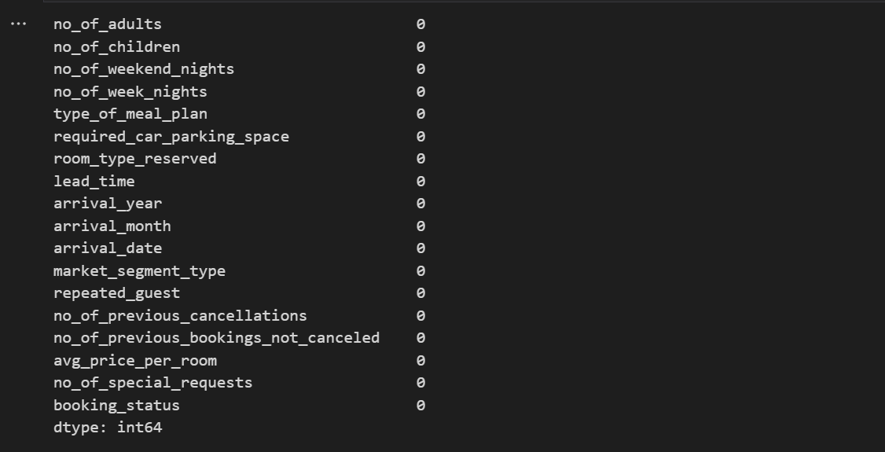
CHECK FOR NULL VALUES

Slide 7
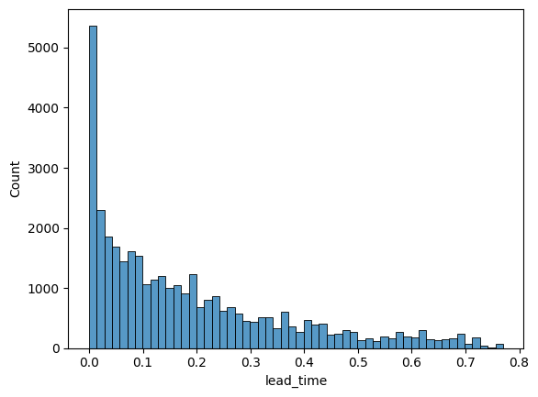
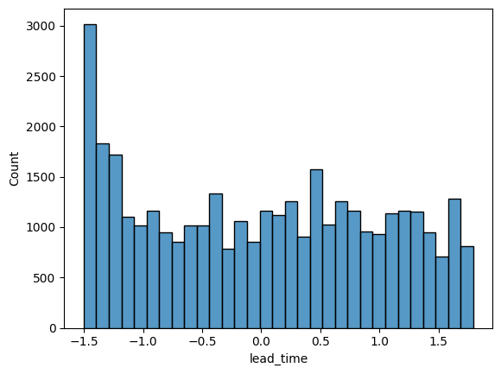
TRANSFORMATION
Before
After

Slide 8
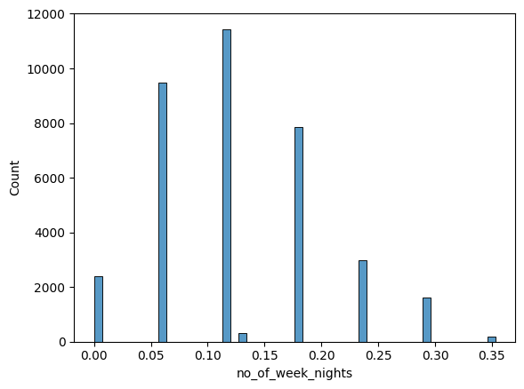
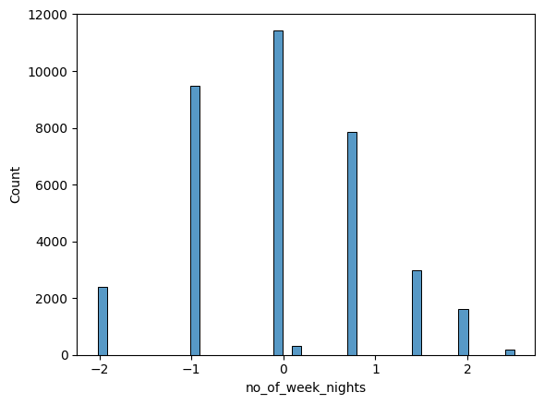
TRANSFORMATION
Before
After

Slide 9
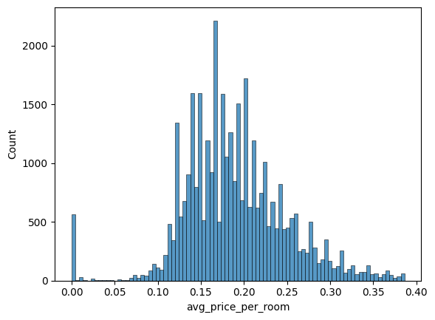
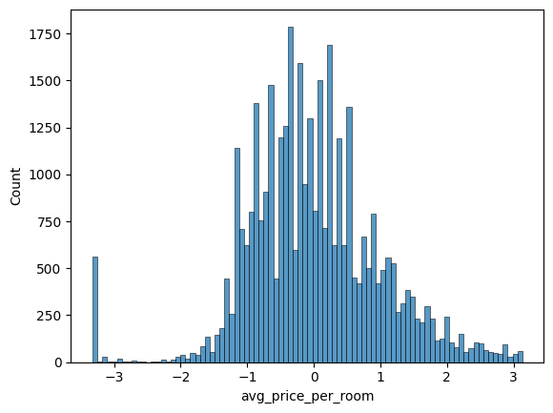
TRANSFORMATION
Before
After

Slide 10
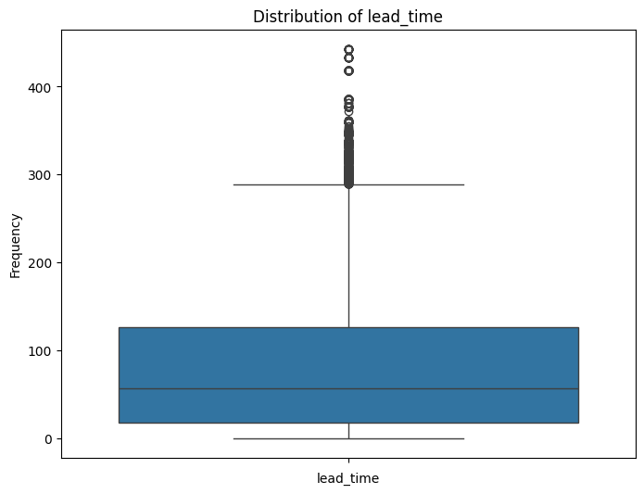
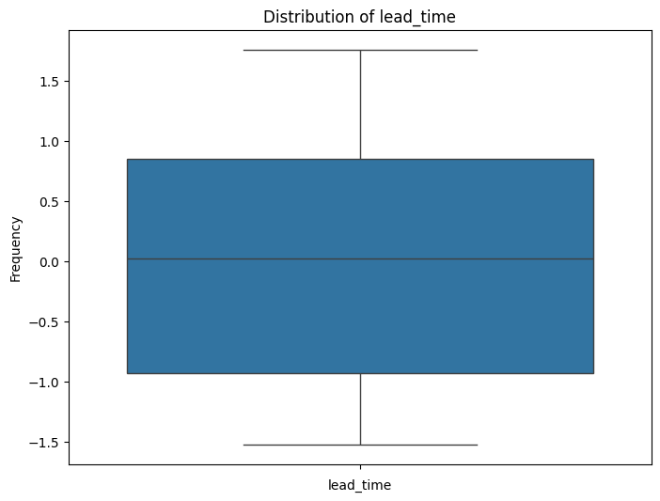
OUTLIER REMOVAL
Before
After

Slide 11
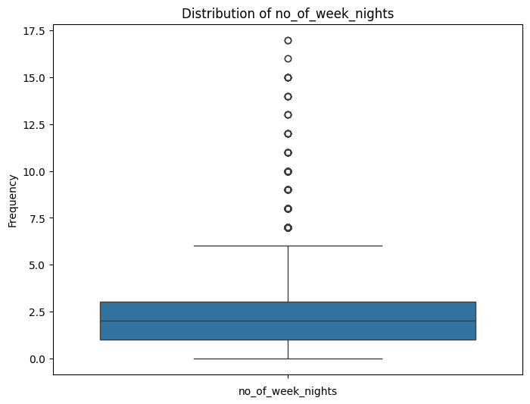
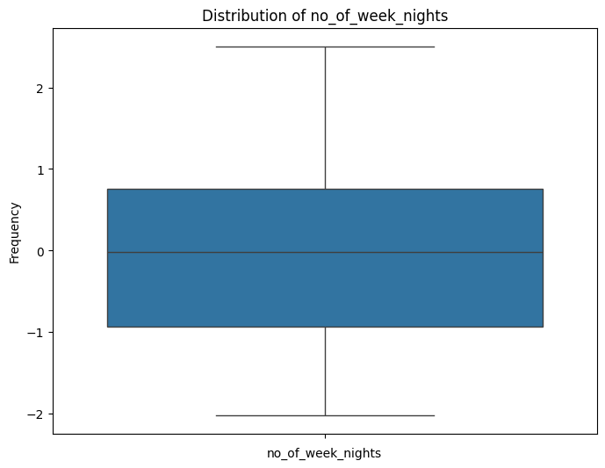
OUTLIER REMOVAL
Before
After

Slide 12
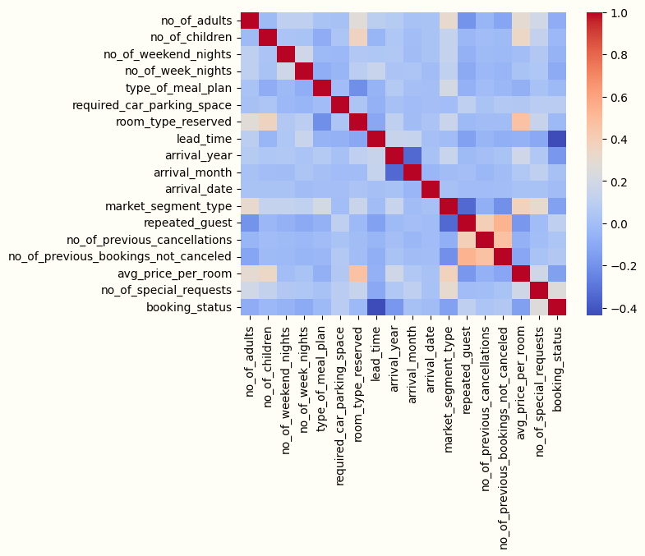
HEAT MAP
This heatmap contains correlation between numerical value and categorical (encoded) values of dataset
It shows that lead_time has highest correlation with target variable booking_status
We will use lead_time (no. of days between booking date and arrival date) for bivariate analysis

Slide 13
TYPES OF CLASSIFICATION
Logistic Regression
Linear Discriminant Analysis
Quadratic Discriminant Analysis
Support Vector Machine
K-Nearest Neighbors

Slide 14
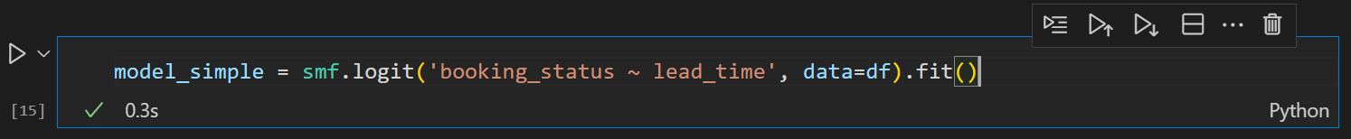
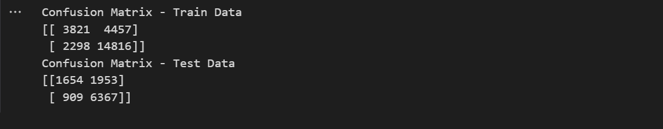
LOGISTIC REGRESSION (BIVARIATE)

Slide 15
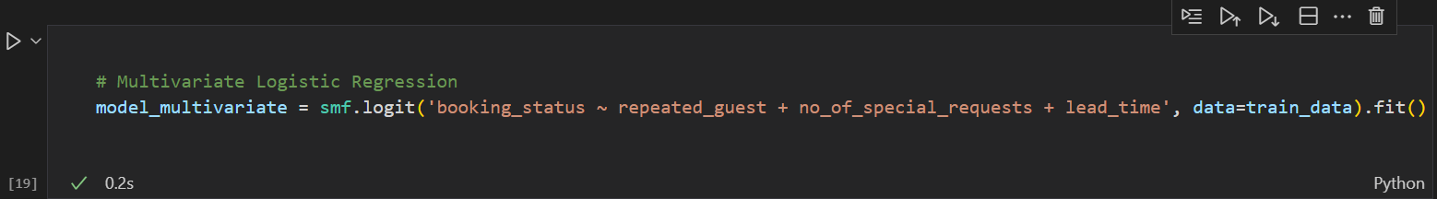
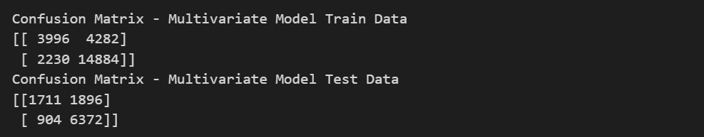
LOGISTIC REGRESSION (MULTIVARIATE)

Slide 16
LOGISTIC REGRESSION OUTCOME
BIVARIATE ANALYSIS | MULTIVARIATE ANALYSIS
Training Accuracy: 0.73 | Training Accuracy: 0.74
Training Precision: 0.87 | Training Precision: 0.87
Training Recall: 0.46 | Training Recall: 0.48
Training F1-Score: 0.81 | Training F1-Score: 0.82
Test Accuracy: 0.74 | Test Accuracy: 0.74
Test Precision: 0.88 | Test Precision: 0.88
Test Recall: 0.46 | Test Recall: 0.47
Test F1-Score: 0.82 | Test F1-Score: 0.82

Slide 17
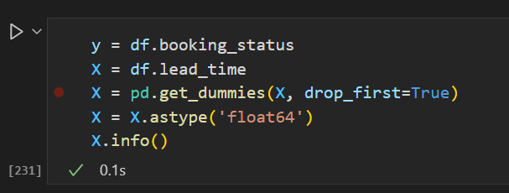
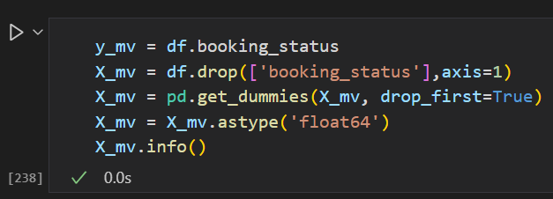
FEATURE AND TARGET SELECTION
Bivariate
Multivariate

Slide 18
Linear discriminant analysis
BIVARIATE ANALYSIS | MULTIVARIATE ANALYSIS
Training Accuracy: 0.77 | Training Accuracy: 0.78
Training Precision: 0.78 | Training Precision: 0.81
Training Recall: 0.93 | Training Recall: 0.87
Training F1-Score: 0.85 | Training F1-Score: 0.84
Test Accuracy: 0.77 | Test Accuracy: 0.78
Test Precision: 0.77 | Test Precision: 0.81
Test Recall: 0.93 | Test Recall: 0.88
Test F1-Score: 0.84 | Test F1-Score: 0.84

Slide 19
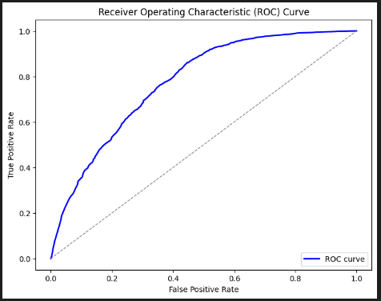
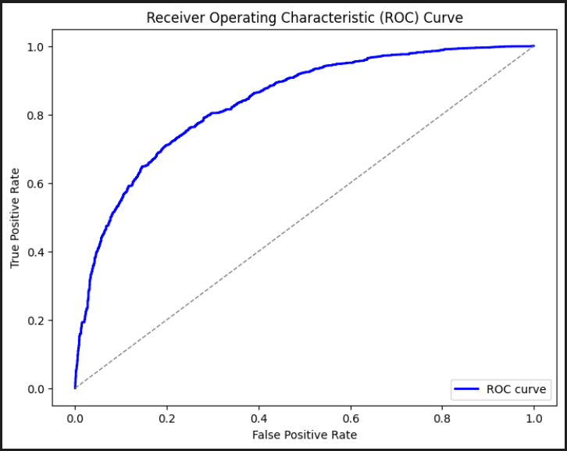
ROC CURVE FOR LDA
Bivariate
Multivariate

Slide 20
QUADRATIC discriminant analysis
BIVARIATE ANALYSIS | MULTIVARIATE ANALYSIS
Training Accuracy: 0.75 | Training Accuracy: 0.44
Training Precision: 0.76 | Training Precision: 0.95
Training Recall: 0.93 | Training Recall: 0.18
Training F1-Score: 0.83 | Training F1-Score: 0.31
Test Accuracy: 0.75 | Test Accuracy: 0.44
Test Precision: 0.75 | Test Precision: 0.94
Test Recall: 0.93 | Test Recall: 0.18
Test F1-Score: 0.83 | Test F1-Score: 0.30

Slide 21
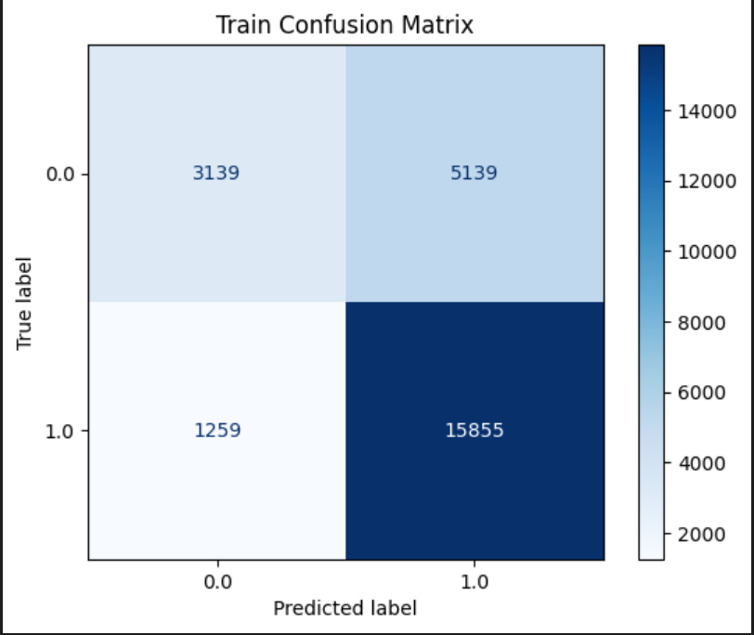
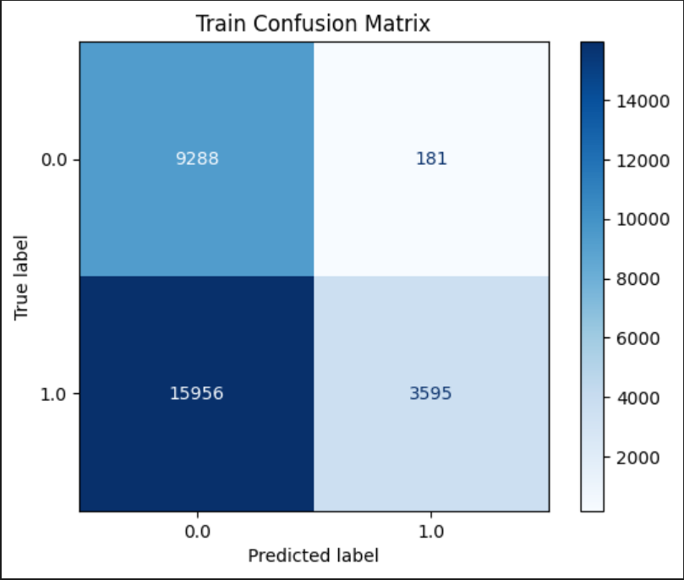
TRAIN CONFUSION MATRICES
Bivariate
Multivariate

Slide 22
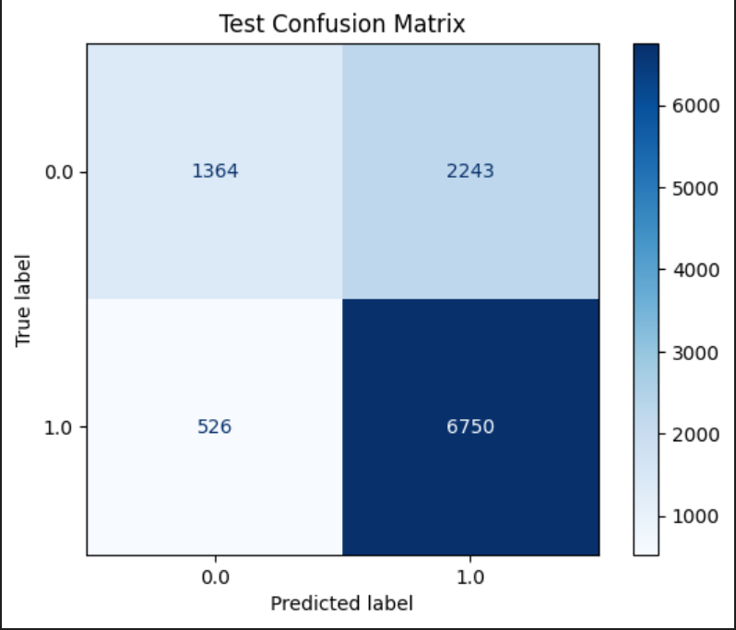
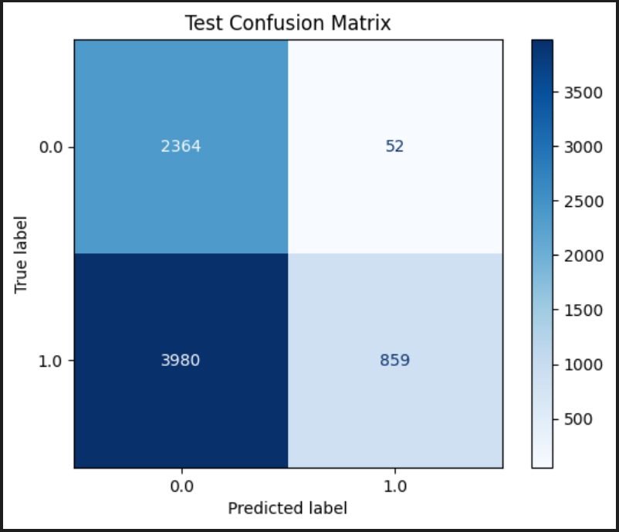
Test CONFUSION MATRICES
Bivariate
Multivariate

Slide 23
SUPPORT VECTOR MACHINE
BIVARIATE ANALYSIS
 | Linear Kernal | Poly Kernal | Rbf Kernel
Training Accuracy: | 0.771950 | 0.772398 | 0.772398
Training Precision: | 0.774202 | 0.776529 | 0.776529
Training Recall: | 0.933865 | 0.929722 | 0.929722
Training F1-Score: | 0.846571 | 0.846249 | 0.846249
Test Accuracy: | 0.766919 | 0.769125 | 0.769125
Test Precision: | 0.766058 | 0.769139 | 0.769139
Test Recall: | 0.936557 | 0.934284 | 0.934284
Test F1-Score: | 0.842771 | 0.843706 | 0.843706

Slide 24
SUPPORT VECTOR MACHINE
MULTIVARIATE ANALYSIS
 | Linear Kernal | Poly Kernal | Rbf Kernel
Training Accuracy: | 0.786216 | 0.786216 | 0.786216
Training Precision: | 0.802887 | 0.802887 | 0.802887
Training Recall: | 0.904813 | 0.904813 | 0.904813
Training F1-Score: | 0.850808 | 0.850808 | 0.850808
Test Accuracy: | 0.786768 | 0.786768 | 0.786768
Test Precision: | 0.799818 | 0.799818 | 0.799818
Test Recall: | 0.907419 | 0.907419 | 0.907419
Test F1-Score: | 0.850228 | 0.850228 | 0.850228

Slide 25
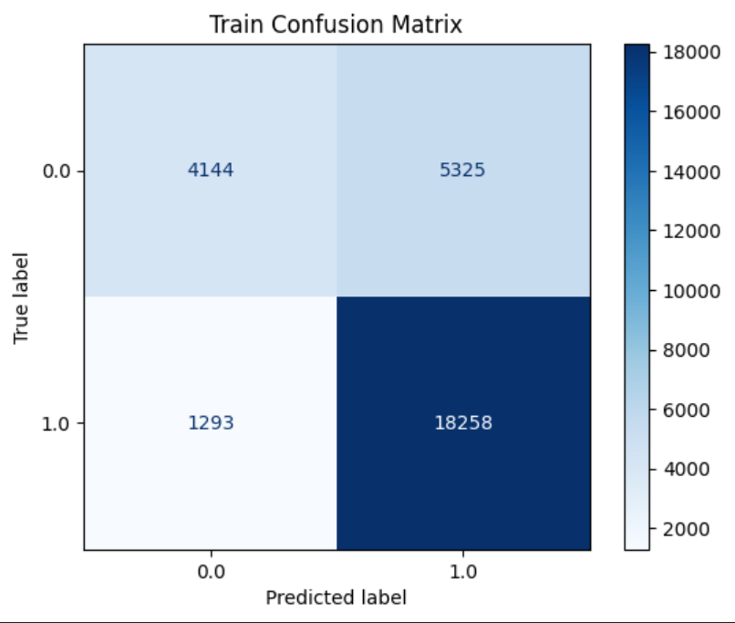

TRAIN CONFUSION MATRICES
Bivariate
Multivariate

Slide 26


TEST CONFUSION MATRICES
Bivariate
Multivariate

Slide 27
K-NEAREST NEIGHBORS
OVERFITTING
BIVARIATE ANALYSIS | MULTIVARIATE ANALYSIS
Training Accuracy: 0.76 | Training Accuracy: 0.99
Training Precision: 0.77 | Training Precision: 0.99
Training Recall: 0.91 | Training Recall: 0.99
Training F1-Score: 0.84 | Training F1-Score: 0.99
Test Accuracy: 0.76 | Test Accuracy: 0.83
Test Precision: 0.77 | Test Precision: 0.867
Test Recall: 0.91 | Test Recall: 0.87
Test F1-Score: 0.83 | Test F1-Score: 0.87

Slide 28
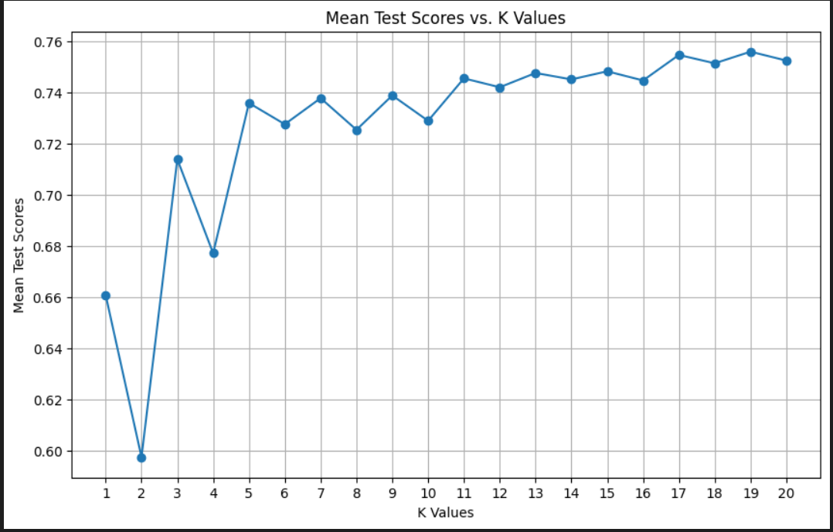
BIVARIATE ANALYSIS
Best K = 19

Slide 29
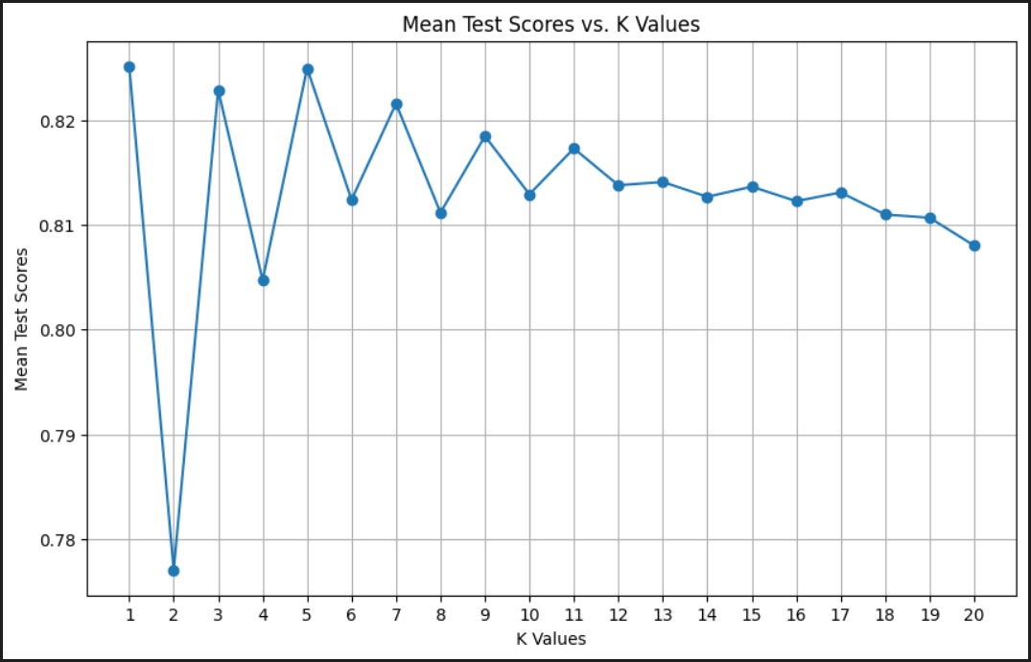
MULTIVARIATE ANALYSIS
Best K = 1

Slide 30
COMPARISON
 | Logistic Regression |  | LDA |  | QDA |  | SVM |  | KNN
 | Bivariate | Multi variate | Bivariate | Multi variate | Bivariate | Multi variate | Bivariate | Multi variate | Bivariate | Multi variate
Training Accuracy | 0.73 | 0.74 | 0.77 | 0.78 | 0.75 | 0.44 | 0.77 | 0.78 | 0.76 | 0.99
Testing Accuracy | 0.74 | 0.74 | 0.77 | 0.78 | 0.75 | 0.44 | 0.77 | 0.78 | 0.76 | 0.83

Slide 31
Conclusion
From the results we conclude that:
Data is linearly related
LDA and SVM(with linear kernel) are giving better results

Slide 32
Thank you

